Slide 1
Car Price Prediction - Data Processing and Modeling

Slide 2
Introduction to the Domain
The car price prediction domain involves forecasting the price of a car based on various features such as make, model, year of manufacture, engine type, and more. This is an important task for the automotive industry and used car markets, helping sellers and buyers estimate prices. Machine learning techniques can accurately predict prices and enhance decision-making for buyers, sellers, and dealerships.

Slide 3
Problem Statement
The problem is to predict the price of a car based on its attributes such as make, model, year, mileage, and other relevant features.

Slide 4
Data Cleaning and Preprocessing
Data cleaning and preprocessing techniques used:
Null value imputation: Missing values were handled by imputing or dropping records based on the type of missingness. For numeric features, the mean or median was used to impute missing values, while categorical features had their missing values imputed with the mode.
Outlier detection and treatment: Outliers were identified using statistical methods (e.g., IQR or Z-scores) and either capped or removed.
Feature encoding: Categorical variables like car make, model, and fuel type were encoded using one-hot encoding to convert them into numerical representations.

Slide 5
Exploratory Data Analysis (EDA)
Univariate analysis: We examined the distribution of individual features like car age, mileage, and price. Features like price showed a skewed distribution, which was corrected through transformation (e.g., log transformation).
Bivariate analysis: We analyzed relationships between features such as car age vs. price, fuel type vs. price, and engine size vs. price. Some features like car age had a strong negative correlation with price.
Multivariate analysis: Correlation heatmaps and pair plots were used to visualize relationships between multiple variables. We found that features like mileage, car age, and engine type had significant effects on car pricing.

Slide 6
Feature Engineering
Feature creation: New features like "car age" were created by subtracting the car's year from the current year. "Price per mile" was also added by dividing price by the number of kilometers driven.
Interaction features: We combined features like 'make' and 'model' to create a new interaction feature to capture the influence of both on the price.
Log Transformation: Since the price distribution was skewed, a log transformation was applied to normalize the target variable.

Slide 7
Statistical Significance
Tests used: We used Chi-square tests for categorical features (e.g., car brand, fuel type) to assess if they had a significant relationship with car price. For continuous variables, Pearson correlation was used to measure linear relationships.
These tests were chosen to validate if our features were indeed predictive of the target variable and to remove irrelevant features.

Slide 8
Class Imbalance Technique
Since this is a regression problem (not classification), class imbalance techniques were not applied. However, we ensured the dataset was well-distributed across car types, price ranges, and regions to prevent biased model learning.

Slide 9
Model Building - Base Model
Linear Regression was chosen as the base model due to its simplicity, interpretability, and ability to provide a baseline for more complex models. This helped to understand if a simple linear relationship existed between features and the target variable.

Slide 10
Models Used in the Project
Several models were tested to identify the best-performing one:
Random Forest Regression: A robust ensemble method capable of capturing non-linear relationships. It handles both numerical and categorical data well and is less sensitive to outliers.
XGBoost Regression: A powerful gradient boosting algorithm that often outperforms other models due to its regularization techniques and high accuracy in predictive tasks.
Ridge and Lasso Regression: These regularized linear models help reduce overfitting by penalizing large coefficients, with Ridge using L2 regularization and Lasso using L1.

Slide 11
Models Used in the Project
Hyperparameter Tuning: Both Random Forest and XGBoost underwent hyperparameter optimization using RandomizedSearchCV. For Random Forest, parameters like `n_estimators`, `max_depth`, and `min_samples_split` were tuned. For XGBoost, hyperparameters such as `learning_rate`, `max_depth`, and `subsample` were tuned to achieve the best performance.

Slide 12
Model Evaluation Metric
The evaluation metrics chosen were:
MSE (Mean Squared Error): Used to measure the average squared difference between the predicted and actual values. It penalizes large errors, which is crucial in price prediction tasks.
R² (R-squared): To measure the proportion of variance explained by the model. A higher R² indicates that the model is explaining most of the variance in car prices.
MAPE (Mean Absolute Percentage Error): Provides a percentage error, making it easier to interpret how off the predictions are in relation to actual values.

Slide 13
Final Model - Selection
The XGBoost model was selected as the final model due to its superior performance in terms of both R² and MAPE after hyperparameter tuning. It handled non-linear relationships between features and the target variable better than Random Forest and Ridge/Lasso regression models.

Slide 14
Conclusion - Feature Importance
From the final XGBoost model, the most important features influencing car price were:
Car age: As expected, older cars tend to have lower prices.
Mileage: Higher mileage generally leads to a lower price.
Engine type: Cars with larger engine sizes (e.g., diesel or petrol engines) often command higher prices.
Make and Model: Luxury and popular brands had a significant impact on the pricing.

Slide 15
Business Suggestions/Solutions
For Sellers: Sellers can use the model to set competitive prices based on the car's age, mileage, and brand.
For Dealerships: Dealerships can leverage the model to assess the fair market value of cars quickly, streamlining the pricing process and improving profitability.
For Buyers: Buyers can use the model to check if a car's asking price is reasonable based on its features.
Feature Insights: Sellers and dealerships can focus on high-demand brands or optimize their inventory based on price-driving features like mileage and engine type.

Slide 16
Streamlit Application User Guide
The Streamlit application is designed to be intuitive and easy to use.
Here’s a step-by-step guide to help you navigate the app.
Open the application in a web browser by navigating to the provided URL.

Slide 17
Input Car Details
Make: Select the car’s make (e.g., "Maruti", "Honda", "Ford") from the drop-down menu.
Model: Choose the specific model from the list.
Body Type : It will show you the body type of that selected car.
Fuel Type: Choose between "Petrol", "Diesel", "CNG", etc.
Transmission: Select "Manual" or "Automatic".
Seats: It will give you seats available on that car.
Variant : All variants of the selected car will be available
Year of manufacture : we can give Year of car manufactured
Kilometers Driven: Use the slider to input the number of kilometers the car has been driven.
Number of Owners: Select the number of previous owners.
Mileage : Limit of mileage will get selected
City: Choose the city where the car is being sold

Slide 18
Predict Price
Click the "Predict" button.
The application will instantly display the predicted price of the car.
Along with car age and efficiency mileage score.

Slide 19
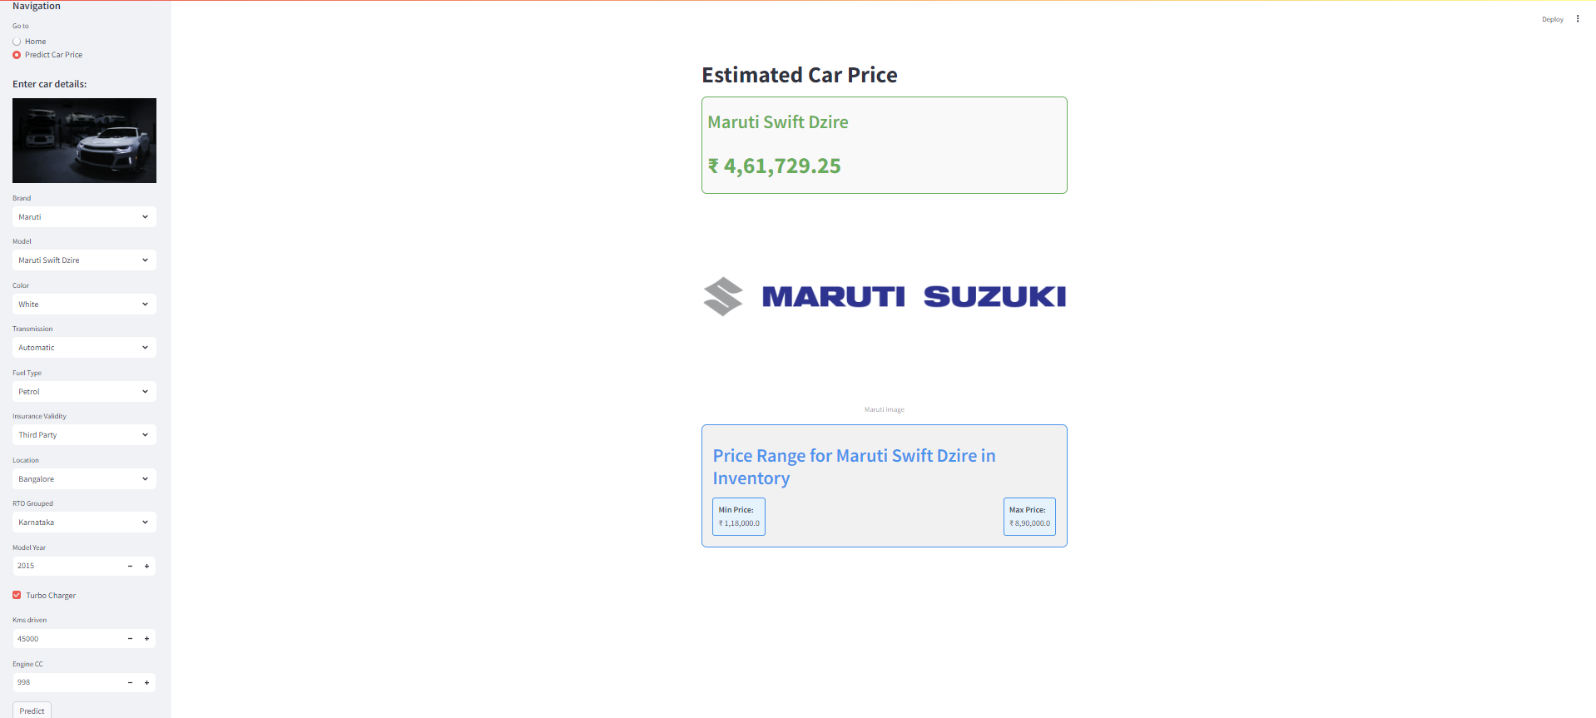

Slide 20
THANK YOU

